Slide 1
Intermediate Analytics ALY6015 Lecture 4: Clustering and Classification

Slide 2
Welcome! Today’s Agenda
Administrative Notes
Lecture – Part 1
<BREAK>
Lecture – Part 2
Assignment #4 Overview
Group Project Overview
Notes:
.

Slide 3
Administrative Notes
Final Project Groups:
Trupti and Jasmine
Canlin and Johnson
Sabrina, Swati, and Zhexuan
Reinaldo and Kalyani
Geethanjali and Jason

Slide 4
Course Tracker
Descriptive statistics in R (Week 1)
Graphical representation of data in R (Week 1)
Inferential statistics in R (Week 2)
Hypothesis testing (Week 2)
Regression Analysis (Week 2)
Regularization and Lasso Modeling (Week 3)
Data Mining (TODAY)
Clustering and Classification (TODAY)
Time Series Forecasting (Week 5)
Bringing it all together – Group Project (Week 6)

Slide 5
Lecture Part 1

Slide 6
Machine Learning
In statistical or machine learning, there are two approaches to learning: **supervised or unsupervised learning**. Problems with clearly defined "predictors” and "responses" are supervised learning. In supervised learning Y (response/outcome variable) is given and the algorithm tries to classify the Xs (IV/predictor/input/regressor/covariate variables). **Regression and Classification** are two methods of supervised learning.
In unsupervised learning there is no Y given, just a set of predictors. **Principal component analysis** and **Clustering** are two unsupervised learning methods. PCA can be used to pre-process data before supervised technique is applied. Clustering can be used to search data for similarities, detect patterns and subgroups, or identify outliers within a dataset.

Slide 7
Regression vs. Classification
Unlike Regression which tries to predict a **continuous** Y variable (e.g., volume of rain), in Classification we try to predict a **categorical** or a qualitative Y variable (example, the titanic dataset has categorical variables: survived or died, class type, etc.).
The goal of classification is to classify examples into given set of categories based on classification rule and labeled data. Spam filtering is an example of text classification while your Iphone X's facial detection is a machine vision classification, and speech to text is based on natural language processing classification.
There are a number of classification models which include logistic classification, decision tree, random forest, gradient-boosted tree, Naive Bayes, etc..

Slide 8
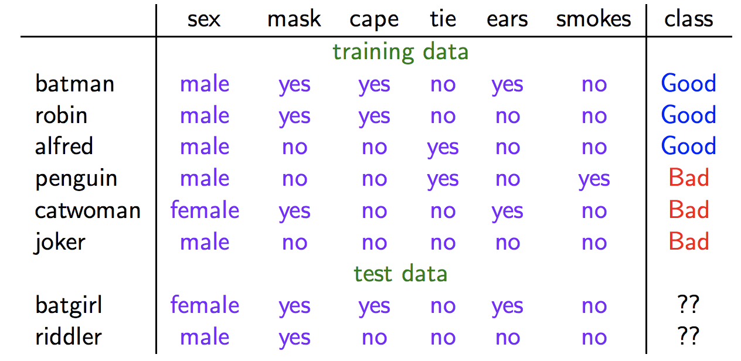
Why use classification?
Machine learnt classifications are often much more accurate than human-crafted rules, not to mention how cheap and fast they are in comparison. However, some of the disadvantages are that they are prone to errors and require a lot of labeled data.
Example: identify people as good or bad from their appearance.

Slide 9
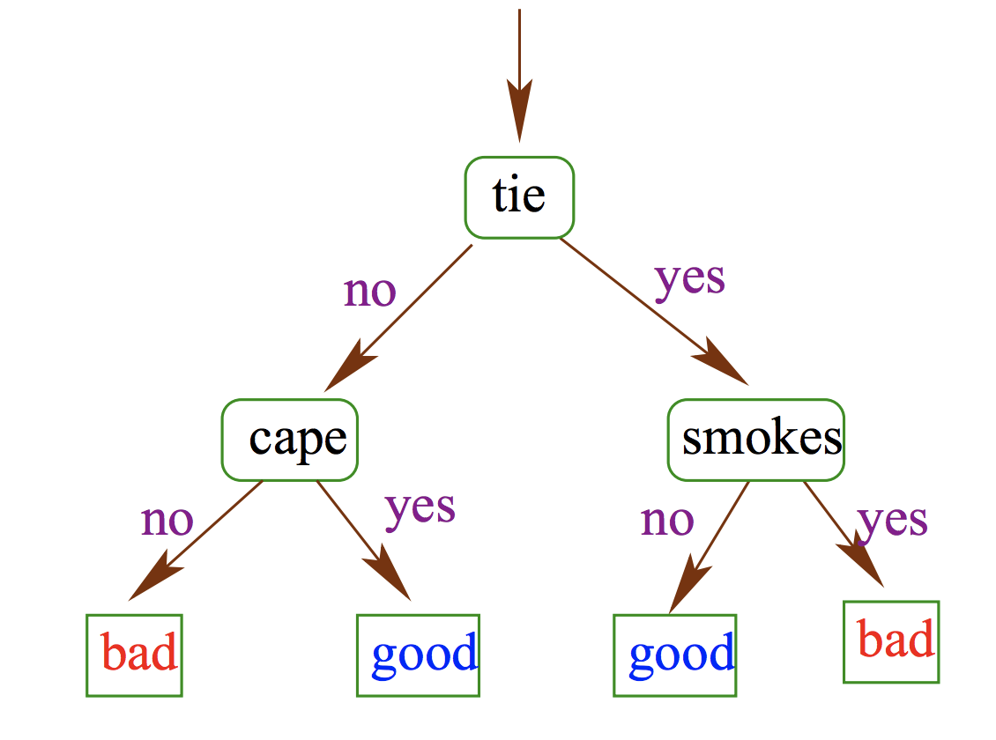
Classification Example?
Classifiers can be overly complex with many rules that's hard to interpret or overly simple that doesn't even fit the available data.

Slide 10
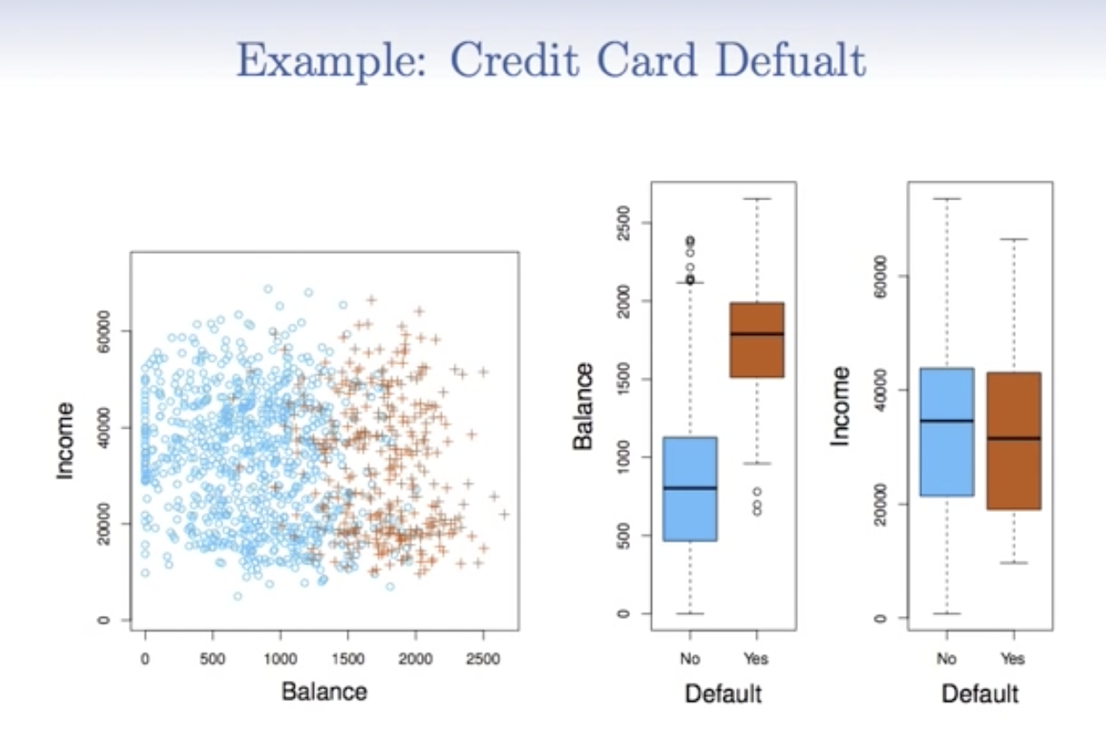
Logistic Regression
Often times we are more interested in the estimate of the probabilities that X belongs to each category in C. For example, we would rather have an estimate of the probability that someone would default on the loan than to classify them as defaulting or not. Logistic regression is used to predict the probability of a binary response based on predictor(s).

Slide 11
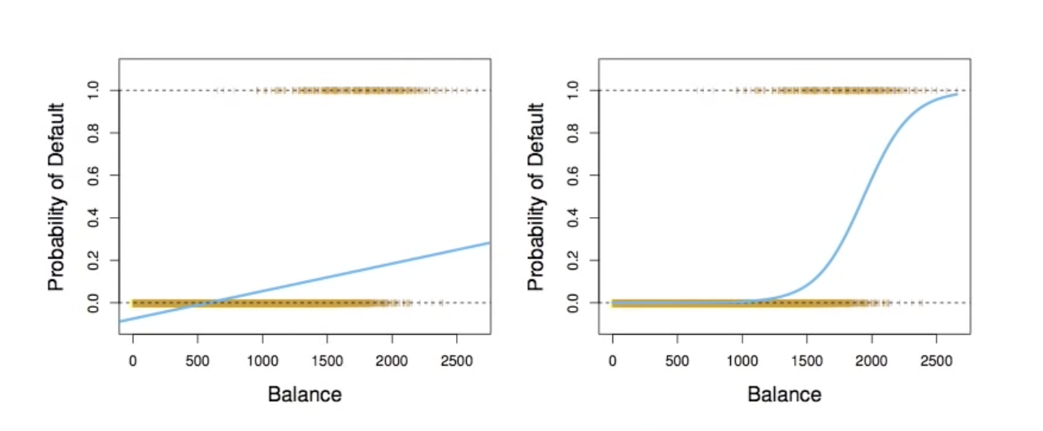
Linear vs Logistic Regression
Logistic regression is a variation of linear regression, where unlike linear regression, the outcome (dependent variable) is categorical in nature and it has only a limited number of possible values (e.g., eyes: brown, blue, green). While you could use linear regression in cases where Y is a binary variable, but it may yield probabilities that are less than 0 or more than 1, therefore, inaccurate.
For example, orange dots represent Y (either 0 or 1), while the blue line is the linear or logistic line. As you can see the linear line goes below 0 and does not reach 1, where there are many of them, so linear regression does not estimate well for **Pr(Y = 1 | X)**. While the logistic regression stays between 0 and 1 and seems well suited for the task.

Slide 12
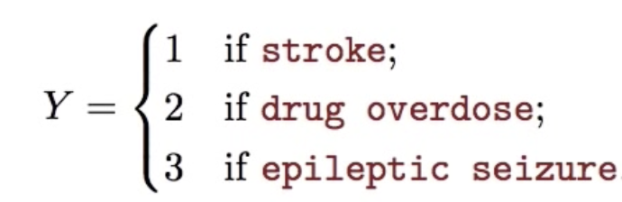
Multi-level response variable
What if our Y is 3-level variable:
Linear regression is not appropriate in this case at all b/c this numbering may imply not only ordering between the levels but also based on the numbering, may imply equal distancers between the three when there is none and may affect our linear regression. **Multiclass Logistic Regression** or **Discriminant Analysis** would be appropriate.

Slide 13
Example of Logistic regression
Follow this example and read the explanation/interpretation
http://r-statistics.co/Logistic-Regression-With-R.html

Slide 14
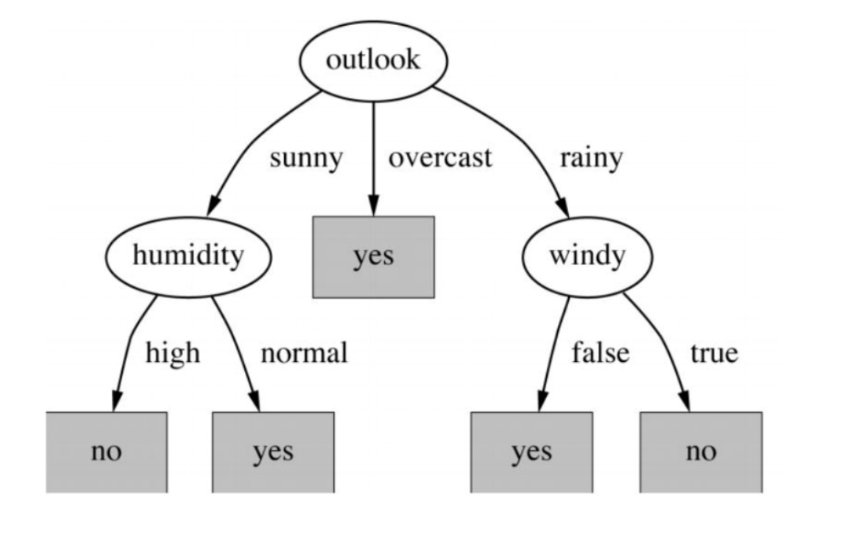
Decision Trees
A decision tree is a way to make a decision by dividing the inputs into smaller decisions. For example, the goal is to make a decision on whether to play golf based on the combination of temperature, humidity, the wind, and whether it is sunny, cloudy, or raining. If it is sunny, mild, not humid, and not windy then the decision to play golf is “yes.” The tree is divided into decision nodes that represent features/attributes, links/branches that represent decision/rule, and leaves that represent an outcome/value/decisions. The idea is to process a tree for the entire data and get an outcome at every leaf.

Slide 15
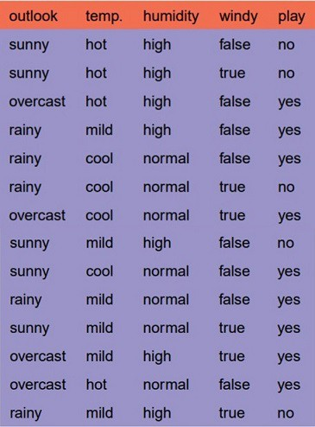
Decision Trees (cont)
There are couple of algorithms/ways there to build a decision tree:
* ID3 which uses entropy and information gains
* CART which uses Gini index
Let's use weather data, which has 4 categorical predictors: outlook, temperature, humidity, and wind. Our Y variable is binary: yes or no, meaning yes or no decision top playing golf.

Slide 16
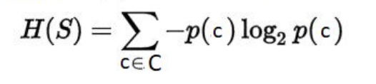
Decision Trees using ID3 algorithm
To create a tree, we need to have a root node (feature). To choose one, we find the feature that best classifies the training data, aka, the feature with the **highest information gain** in ID3.
To define information gain, we need to define entropy. **Entropy (H)))** is a measure of the amount of uncertainty in the data (S).
where,
S - the dataset for which entropy is being calculated
C - set of classes in S (C={yes, no})
p(c ) - the proportion of the number of elements in class c to the number of elements in Set S

Slide 17
Decision Trees using ID3 algorithm
When H(S) = 0, all elements in S are of the same class.
Entropy is calculated for each feature. The feature with the smallest entropy is used to split the set S on any iteration. The higher the entropy, the bigger the potential to improve the classification.
* If all examples are of negative class (or positive), the entropy is zero as there is no uncertainty.
* If half of the examples are of positive class and half are of negative class, the entropy is one (high).

Slide 18
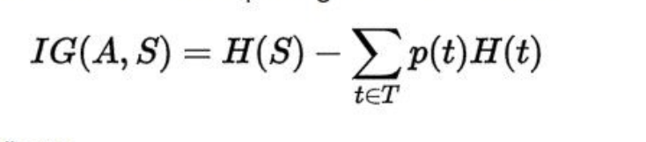
Decision Trees using ID3 algorithm
Information gain is the measure of the difference in entropy from before to after the dataset S is split on a feature A, aka, how much uncertainty in S was reduced after splitting set S on feature A.
where,
H(S) - entropy of set S
T - the subsets created from splitting set S by attribute A
p(t) - the proportion of the number of elements in t to the number of elements in set S
H(t) - entropy of subset
The attribute with the largest information gain is used to split the set S on this iteration.

Slide 19
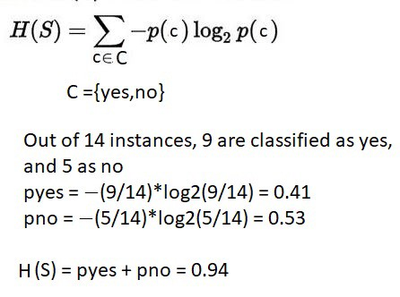
Decision Tree Example Step by Step
Step 1: compute entropy for the dataset
C= {yes, no}

Slide 20
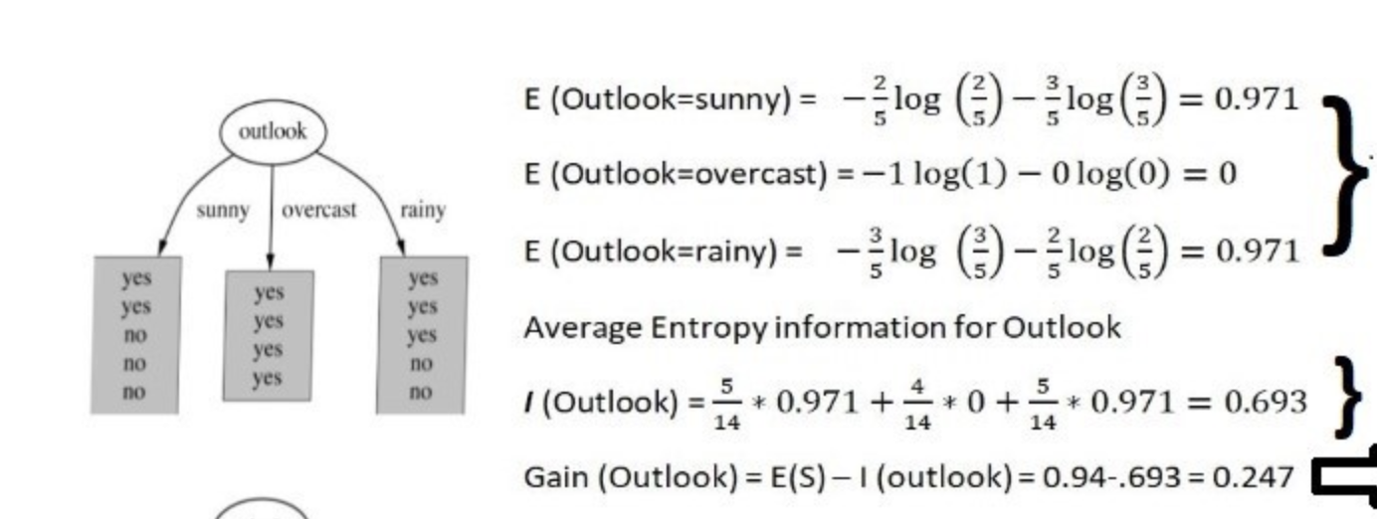
Decision Tree Example Step by Step
Step 2: for every feature
* calculate entropy for all values in each feature
* calculate average entropy information for each feature
* calculate information gain for each feature

Slide 21
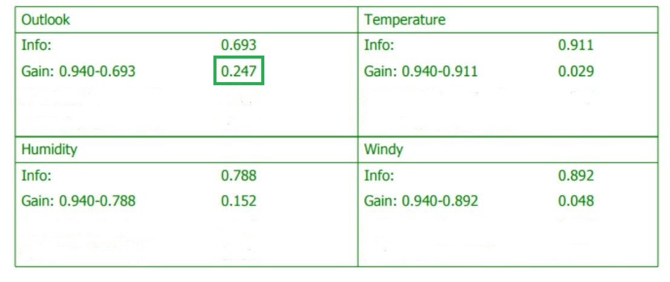
Decision Tree Example Step by Step
Step 3: pick the highest gain feature

Slide 22
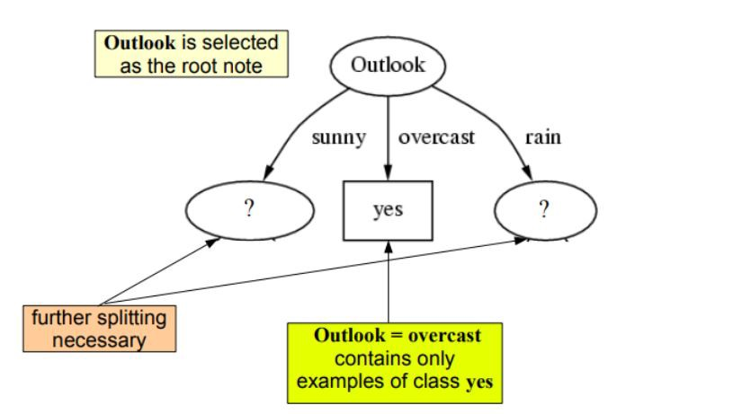
Decision Tree Example Step by Step
Step 4: repeat until we get the tree

Slide 23
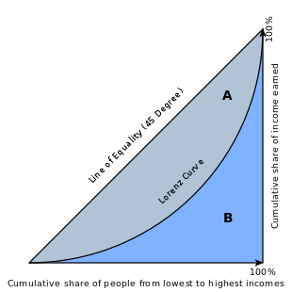
Decision Trees using CART
In CART we use Gini index as a metric, as our cost function used to evaluate splits in the dataset (vs Gain in ID3)

Slide 24
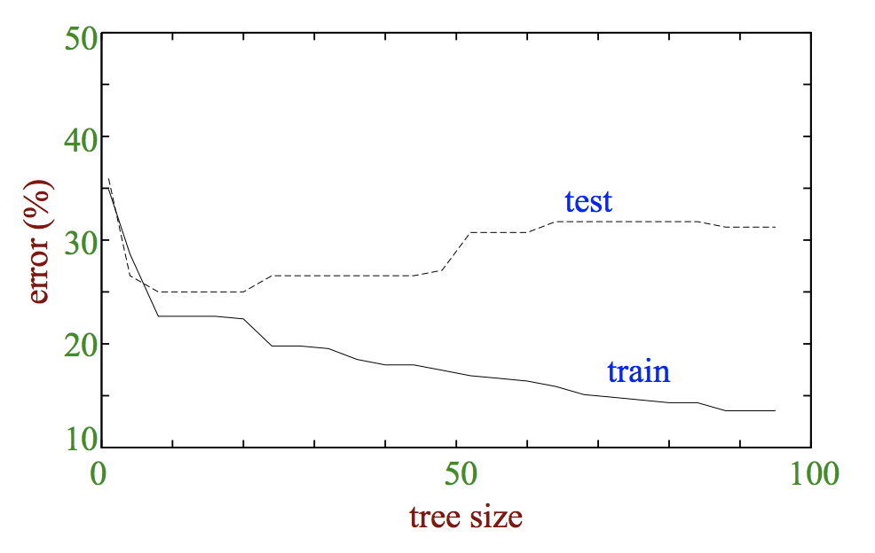
Tree size vs accuracy
Trees must be big enough to fit training data, so that "true" pattern are fully captured. But trees that are too big may overfit.
Unfortunately as you can see in this image, you can't tell best tree size from training error.

Slide 25
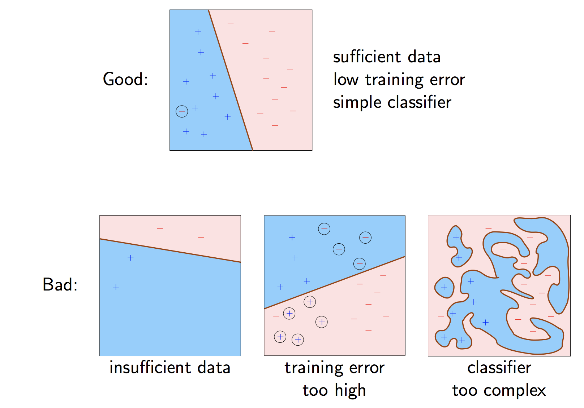
Good v Bad Classifier

Slide 26
Decision Tree Example
Either https://davetang.org/muse/2013/03/12/building-a-classification-tree-in-r/
OR https://www.statmethods.net/advstats/cart.html (only the classification tree example)

Slide 27
Random Forest
This approach to classification is similar to the decision tree, except the questions that are posed include some randomness. The goal is to push out bias and group outcomes based upon the most likely positive responses. These collections of positive responses are called bags.
An example application of the Random Forest model is the algorithm Netflix uses to recommend movies. It looks at people who have similar tastes and then recommends movies that way. It tosses out outlier answers by using randomness to avoid skewing the response in an incorrect direction.

Slide 28
Random Forest in R
Package randomForest
* very fast
* cannot handle data with missing values
* a limit of 32 to the maximum number of levels of each categorical attribute
* extensions: extendedForest, gradientForest
Package party: cforest()
* not limited to the above maximum levels
* slow
* needs more memory

Slide 29
Random Forest Example
https://www.r-bloggers.com/random-forests-in-r/

Slide 30
Naïve Bayes
Naive Bayes is based on the concept of dependent probability. If you roll a dice, the probability of getting a 6 is 1/6 since there are 6 sides. What is the probability that you get a 5 after rolling a 6? It’s not any different than if you rolled a 3 or any other number instead of a 5 as those are completely independent events. So the probability of rolling a 6 and then a 5 is (1/6)*(1/6).
Dependent probability is based on what is the chance of some outcome given some other outcome. The chance that an email is spam is based on these three things:
How many spam messages do you receive over some period of time?
How many of those contain some word associated with spam, like “lottery.”
How many emails containing the word lottery were marked by users as spam?

Slide 31
Question
So what is the probability that a newly received email is spam given that it contains the word ‘lottery’?
((probability of spam given “lottery”) * (probability of spam for all mail)) / (probability of an email containing the word “lottery”)

Slide 32
Classification in R
Make sure your Y variable is encoded as factor in R.
In R, use GLM function to fit a logistic regression using family = binomial.
Look at the summary to find your significant coefficients or look at your AIC and residual deviance.
Then use predict(glm.fit) to see the probabilities.
Then turn those probabilities into classifications through setting a threshold.

Slide 33
Example of Classification in R
Use this link to do the following example and read the interpretation.
https://rstudio-pubs-static.s3.amazonaws.com/21379_a214540189fb45f1915ba171c286a9d1.html#example-1-college-admissions
Example 2: Stock Market Data

Slide 34
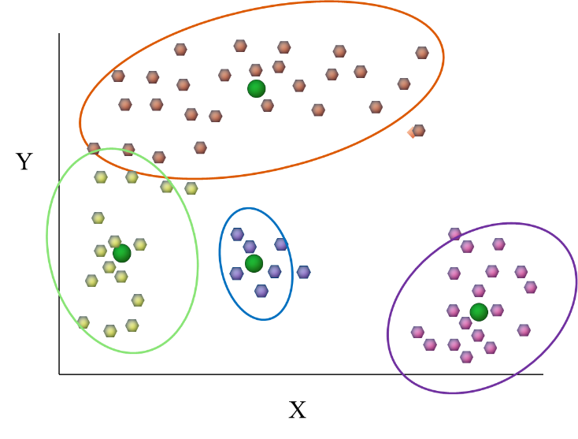
Unsupervised Learning: Overview
As we already discussed, Clustering is a method of unsupervised learning. Here, we do not have Y, a label, and we are trying to group the data based on the Xs.
Clustering is the task of dividing the population or data points into a number of groups such that data points in the same groups are more similar to other data points in the same group than those in other groups. In simple words, the aim is to segregate groups with similar traits and assign them into clusters.
X2
X1

Slide 35
Pros and Cons of Unsupervised Learning
Unsupervised learning is more subjective and there is no simple goal such as prediction. However, these techniques are very important in business applications, especially for finding patterns and creating grouped solutions.
Additionally, there is more unlabeled data than there is labeled. So there is no need for costly human intervention.

Slide 36
Clustering Analysis: Overview
Let’s understand this with an example. Suppose, you are an educator and you need to offer remediation to your students. You can't possibly look into the performance of every single student and then devise remediation plan for each one of them. But, what you can do is to cluster all of your students into say 5 groups based on their performance and attendance and create remediation plans for students in each of these 5 groups. And this is what we call clustering.

Slide 37
Types of Clustering Algorithm (most known)
There are many methods of conducting clustering, Every methodology follows a different set of rules for defining the ‘similarity’ among data points and their distance. The following are the most used algorithms:
* Connectivity models: As the name suggests, these models are based on the notion that the data points closer in data space exhibit more similarity to each other than the data points lying farther away
These models can follow two approaches. In the first approach, they start with classifying all data points into separate clusters & then aggregating them as the distance decreases. In the second approach, all data points are classified as a single cluster and then partitioned as the distance increases
Also, the choice of distance function is subjective. These models are very easy to interpret but lacks scalability for handling big datasets. Examples of these models are **hierarchical clustering** algorithm and its variants.

Slide 38
Types of Clustering Algorithm (most known)
* Centroid models: These are iterative clustering algorithms in which the notion of similarity is derived by the closeness of a data point to the centroid of the clusters.
**K-Means** clustering algorithm is a popular algorithm that falls into this category. In these models, the number of clusters required at the end have to be mentioned beforehand, which makes it important to have prior knowledge of the dataset. These models run iteratively to find the local optima.

Slide 39
Types of Clustering Algorithm (least known)
* Distribution models: These clustering models are based on the notion of how probable is it that all data points in the cluster belong to the same distribution (For example: Normal, Gaussian). These models often suffer from overfitting. A popular example of these models is **Expectation-maximization** algorithm which uses multivariate normal distributions.
* Density Models: These models search the data space for areas of varied density of data points in the data space. It isolates various different density regions and assign the data points within these regions in the same cluster. Popular examples of density models are **DBSCAN** and **OPTICS**.

Slide 40
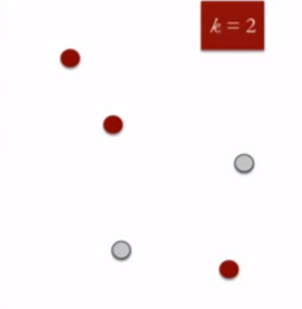
K-means: Step 1
K means is an iterative clustering algorithm that aims to find local maxima in each iteration. This algorithm works in these 6 steps:
1. Specify the desired number of clusters K : For this example, let's try k=2 for 5 data points in 2-D space.

Slide 41
K-means: Step 2
Randomly assign each data point to a cluster : Let’s assign three points in cluster 1 shown using red color and two points in cluster 2 shown using grey color.

Slide 42
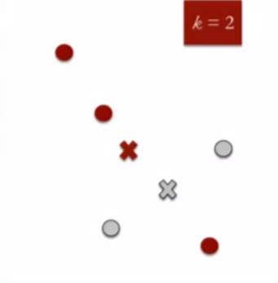
K-means: Step 3
Compute cluster centroids (the mean position of all the points in all of the coordinate directions): The centroid of data points in the red cluster is shown using red cross and those in grey cluster using grey cross.

Slide 43
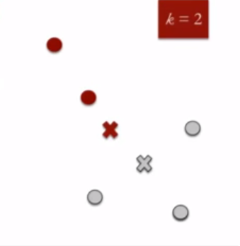
K-means: Step 4
Re-assign each point to the closest cluster centroid : Note that only the data point at the bottom is assigned to the red cluster even though its closer to the centroid of grey cluster. Thus, we assign that data point into grey cluster.

Slide 44
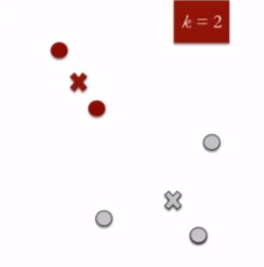
K-means: Step 5
Re-compute cluster centroids : Now, re-computing the centroids for both the clusters.

Slide 45
K-means: Step 6
Repeat steps 4 and 5 until no improvements are possible

Slide 46
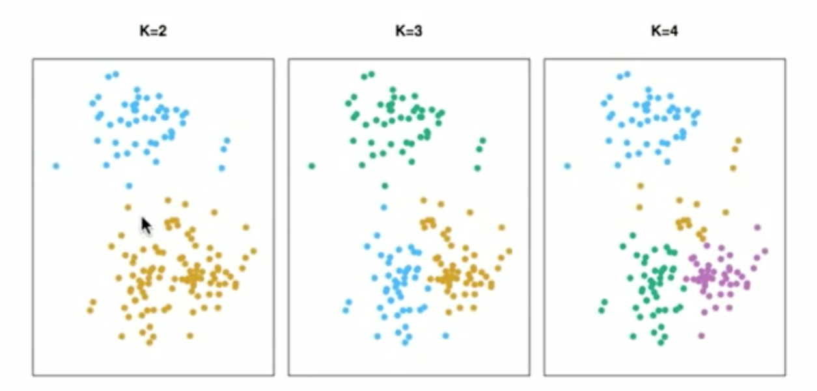
Example of K-means Clustering
Here you can see the results from applying k-means clustering with different values of K (2 through 4).
Each observation belongs to at least one of the k clusters and no observation belongs to more than one cluster. However, the accuracy of it is rather subjective. A good clustering is one for which the within-cluster variation is as small as possible. This is the measure of distance

Slide 47
Euclidian Distance
Normally within cluster variation is the Euclidean distance: pairwise squared distance between each pair of observations in cluster. So when we find the centroid of a cluster, to assign data points to that cluster, we use Euclidena distance to identify the points closest to the centroid.

Slide 48
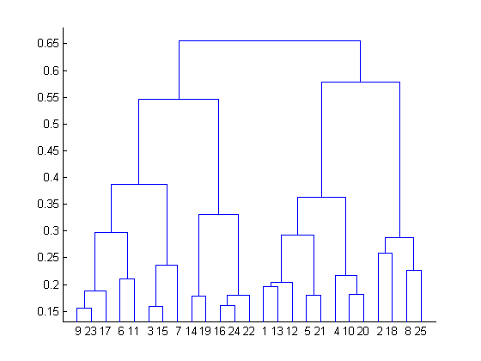
Hierarchical Clustering
Hierarchical clustering, as the name suggests is an algorithm that builds hierarchy of clusters. This algorithm starts with all the data points assigned to a cluster of their own. Then two nearest clusters are merged into the same cluster. In the end, this algorithm terminates when there is only a single cluster left. This is the bottom up or agglomerative clustering approach, which is the most common type of hierarchical clustering.
The results of hierarchical clustering can be shown using dendrogram and it does not require a predefined number of K.

Slide 49
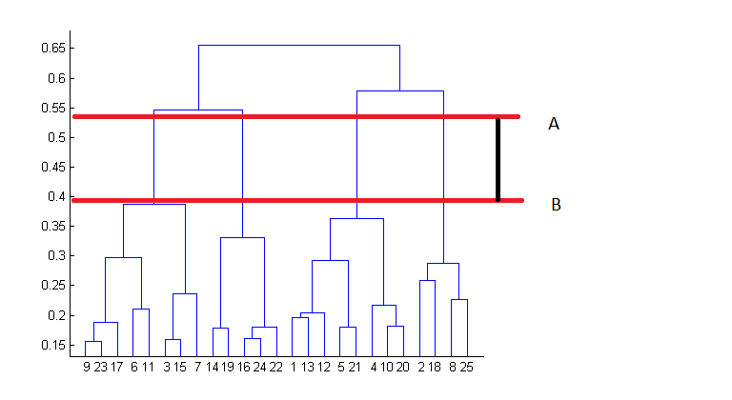
Dendrogram
At the bottom, we start with 25 data points, each assigned to separate clusters. Two closest clusters are then merged till we have just one cluster at the top. The **height** in the dendrogram at which two clusters are merged represents the **distance** between two clusters in the data space.
The decision of the number of clusters that can best depict different groups can be chosen by observing the dendrogram. The best choice of the number of clusters is the number of vertical lines in the dendrogram cut by a horizontal line that can transverse the maximum distance vertically without intersecting a cluster.

Slide 50
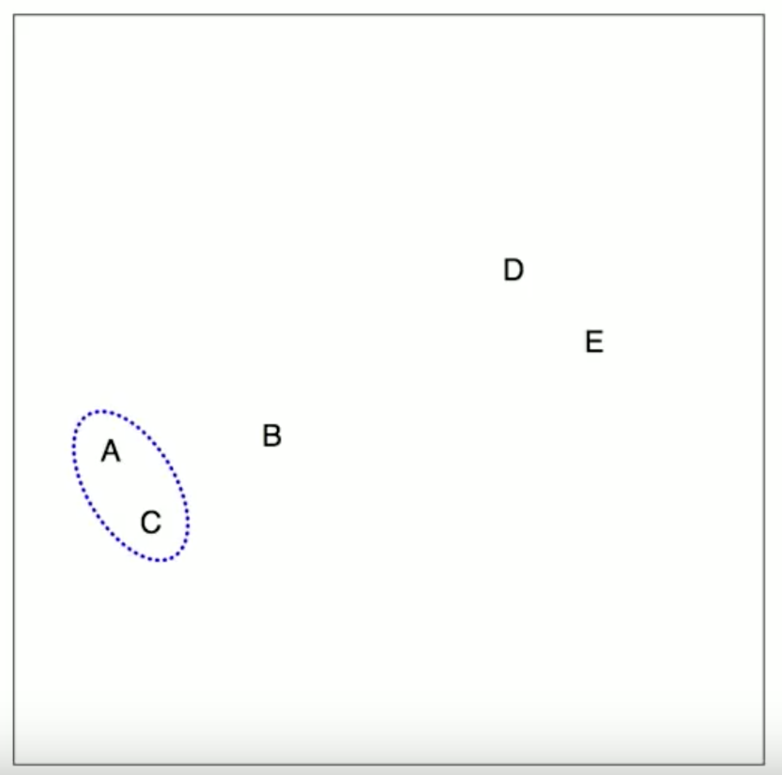
Hierarchical Clustering in Steps: Step 1
This example's data has 5 objects and two features (x and y axes).
Step 1: Based on squared distance (or other method), looks for the closest pair of objects in terms of distance and joins them in one cluster.

Slide 51
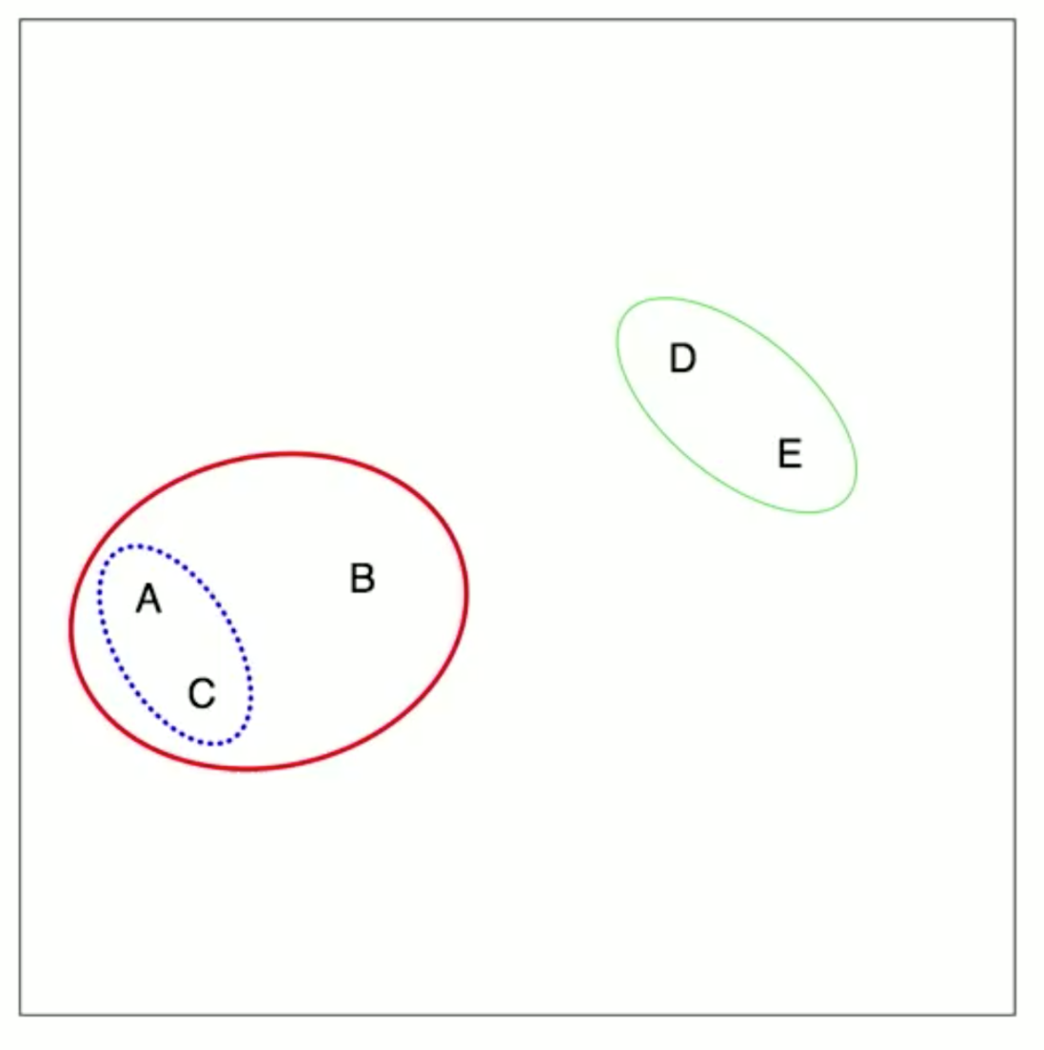
Hierarchical Clustering in Steps: Step 2
Step 2: Once all the pairs are joined, it looks for joining cluster or a cluster with an observation

Slide 52
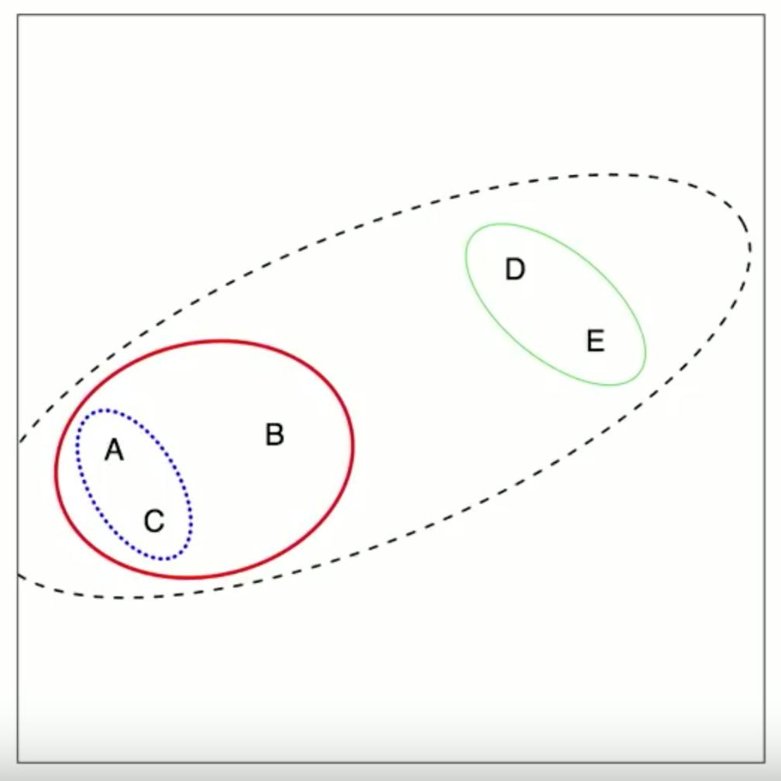
Hierarchical Clustering in Steps: Step 3
Step 3: Continue until all the data is in one cluster.

Slide 53
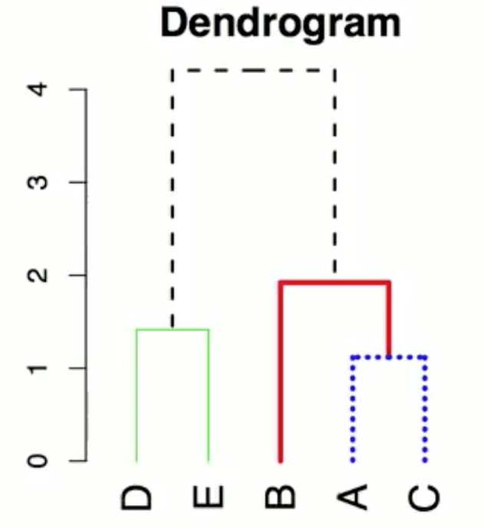
Hierarchical Clustering in Steps: Step 4
Step 4: Construct a dendrogram to summarize the clusters. 2-D graph is capable of easily depicting two features, while dendrogram does not have that limitation.
The bottom is the leaves of the tree, the objects labeled A-E. The height of joins are draw at the height of the squared distance between the two points, A and C, or D and E.

Slide 54
Types of Linkage
Linkage is a measure of the distance between a point and a cluster or two clusters. The way it's calculated is based on its type.
* Complete: maximal inter-cluster dissimilarity. Compute all pairwise distances between the observations in cluster A and the observations in cluster B, and record the largest of these distances. This is also called farthest neighbor.
* Single: minimal inter-cluster distances The same as above but choose the smallest of the distances. This is also called nearest neighbor.
* Average: mean inter-cluster distances The same as above but record the average of the distances.
* Centroid: dissimilarity between the centroid for cluster A and the centroid for cluster B.

Slide 55
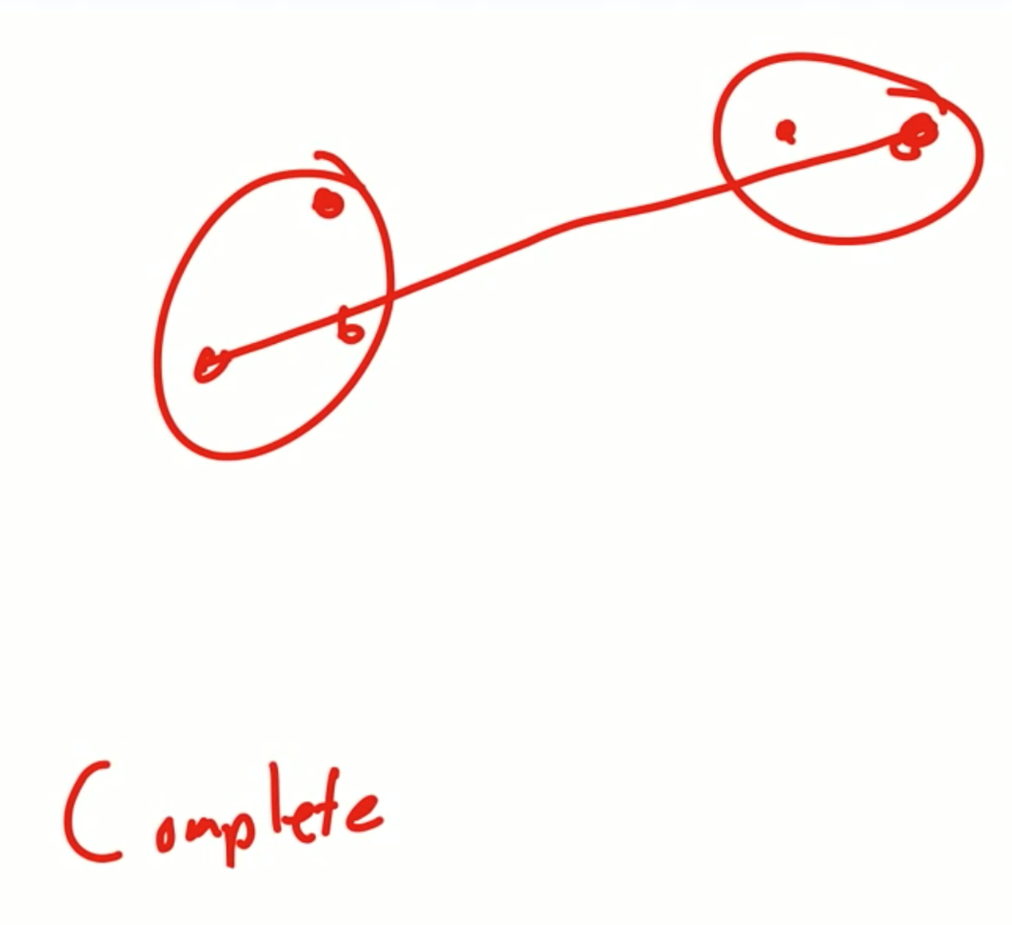
Linkage Examples
Complete (farthest)

Slide 56
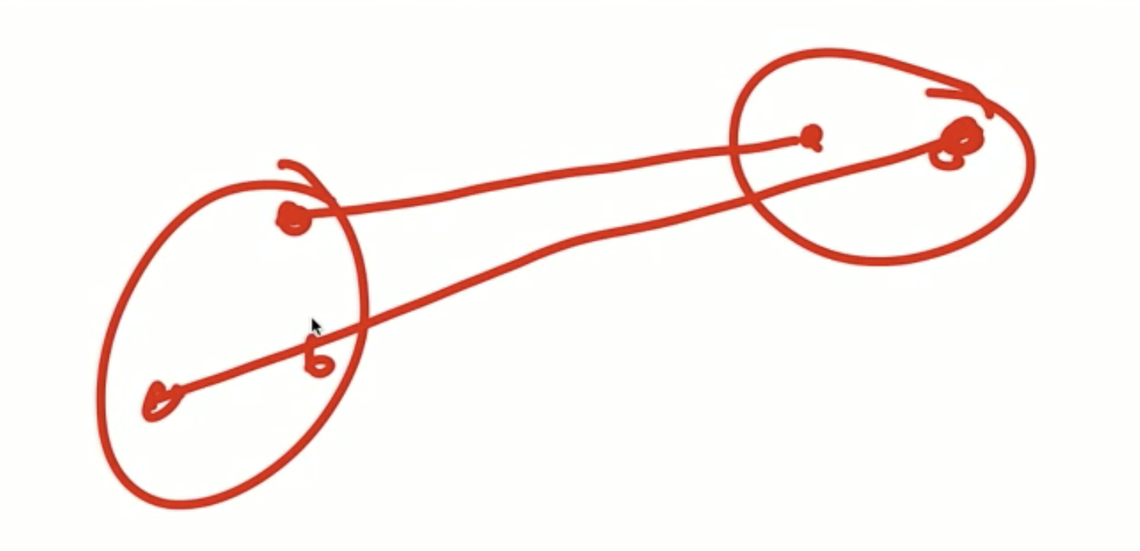
Linkage Examples
Single (closest)

Slide 57
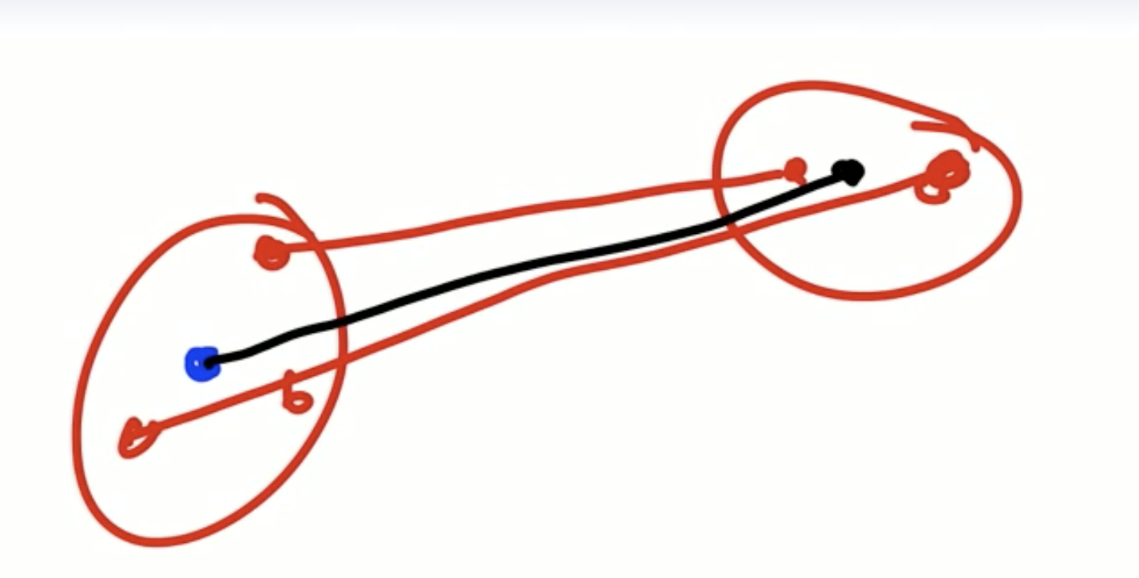
Linkage Examples
Centroid (average of points in each cluster)
Complete and Centroid are used most commonly.

Slide 58
Top Down Hierarchical Clustering
This algorithm has been implemented above using bottom up approach. It is also possible to follow top-down approach starting with all data points assigned in the same cluster and recursively performing splits till each data point is assigned a separate cluster.
The decision of merging two clusters is taken on the basis of closeness of these clusters. There are multiple metrics for deciding the closeness of two clusters :
* Euclidean distance: ||a-b||2 = √(Σ(ai-bi))
* Squared Euclidean distance: ||a-b||22 = Σ((ai-bi)2)
* Manhattan distance: ||a-b||1 = Σ|ai-bi|
* Maximum distance:||a-b||INFINITY = maxi|ai-bi|
* Mahalanobis distance: √((a-b)T S-1 (-b)) {where, s : covariance matrix}

Slide 59
K-means vs. Hierarchical Clustering
* Hierarchical clustering can’t handle big data well but K-means clustering can. This is because the time complexity of K-means is linear i.e. O(n) while that of hierarchical clustering is quadratic i.e. O(n2).
* In K-means clustering, since we start with random choice of clusters, the results produced by running the algorithm multiple times might differ. While results are reproducible in Hierarchical clustering.
* K-means is found to work well when the shape of the clusters is hyper spherical (like circle in 2D, sphere in 3D).
* K-means clustering requires prior knowledge of K i.e. number of clusters you want to divide your data into. But, you can stop at whatever number of clusters you find appropriate in hierarchical clustering by interpreting the dendrogram. However, in k-means you can guide yourself by assessing the drop in cluster error using within-set sum of squared error between points in clusters: choose the number of clusters where the within-set sum of squares is decreasing substantially.

Slide 60
K-means vs. Hierarchical Clustering
* To do clustering, we need to compute distances between points and then put things together that are very close to each other (e.g., bunny is closer to a duck than to a fish)
* While interpreting dendrogram you cannot say the two points are close together if they are by each other, you have to go up to the top where they separate into a separate tree and thats when you will know their difference.

Slide 61
Example of K-means clustering
Read the text and complete this exercise
https://rpubs.com/FelipeRego/K-Means-Clustering

Slide 62
Example of Hierarchical clustering
Read the text and complete this exercise
https://www.r-bloggers.com/hierarchical-clustering-in-r-2/

Slide 63
Week 4 Assignment
This assignment is to practice using R to show how Data Mining techniques, classification and clustering, can be applied to classify or cluster data. Make sure to submit your data, results, plots, and your interpretation.
a) Please use any dataset to conduct a clustering analysis (k-means or hierarchical or both)
OR
b) Please use any dataset to conduct a classification analysis (logistic regression, random forest, or decision tree or all).

Slide 64
Group Project Introduction
As the final assignment in this course, I want you all to be more creative, take some risks, and share a project. Therefore, please use at least one of the methods (i.e., Regression Analysis, Hypothesis Test, Regularization, Data Mining, and Time Series Analysis) we have learned from the first five modules to analyze a real world data of interest to you with a goal of solving a problem you pose. You may use the supporting links I posted in the module six supporting materials folder.
Please come up with some research questions based on the data you chose and apply the analytical methods you have learned in this course, covered in Modules 1-5. Please prepare a report based on your findings that will include the following information:
a cover page with all the student names in your group, course/section, institution, instructor's name, the assignment title, and the date, a section on the research questions, a section on the data set(s) chosen, a section on the method(s) chosen, a section on results & findings, a section on conclusions, references (if any)
appendix: your r script or your analyses document in any other format (excel, tableau, python, etc.)
email: each student in a group should email me 1-2 sentences on how they felt working in the group. I want to hear your reflection of the experience both good or bad.
You shall work in a group of two or three students at most (will be assigned). Your project should follow APA format, however, i won't be posing any page limitations but I expect thorough report. Please approach this as your chance to investigate something of interest to you. You should include images, graphs, figures, charts, and tables as necessary. The deadline will be the last day of class.
If you have any questions, please contact me. However, do not wait until the last day of the assignment's due date to email me with questions/concerns. Start working on it as soon as you can to have a higher chance of success.
This report is due Friday, May 18th but will be presented in class Wednesday, May 16th
I look forward to seeing your creative and analytical work. I know if you put in the effort, you can have some very fascinating results. Work hard!

